Slide 1
mobile app for on the move (OTM) access to Digital forms for logisticians
1stLt O. D. Grandisson
The overall classification of this brief is:
UNCLASSIFIED

Slide 2
a.l.f.a - Anytime logistics forms anywhere
1stLt O. D. Grandisson
The overall classification of this brief is:
UNCLASSIFIED

Slide 3
Where the idea came from
While in Australia supporting the Marine Rotational Force – Darwin, (MRF-D), I witnessed the enormous challenges my neighbor, the S4 logistics officer, endured. He was tasked with coordinating and tracking flights, handling meal requests, executing contracts, assigning billeting, and tracking shipments to support Marines inbound from the U.S., as well as supporting exercises conducted in the Australian Defence Force (ADF) training areas.
Coordinating all of these efforts were difficult enough from his computer, but his job required he personally supervise the arrival of personnel and equipment, attend meetings on different military bases, and visit local vendors.
If he could access request forms, manifests, equipment density lists and other data while on the move, he could reduce the time behind his computer and focus on ensuring mission success, no matter his location.

Slide 4
Orientation
Supply
Transportation
Engineering
Health Services
Services
Maintenance
Six tactical functions of logistics
Notes:
We are warfighters in an ever evolving battlefield. Over the past few years, combat operations require we adapt and use technology available in the private sector to maintain an asymmetric advantage on the battlefield. In order to bring the “beans, bullets, and band-aids” to those outside the wire, it requires to use the latest technology to

Slide 5
Problem
Information on forms is often changed last minute which may impact the timely delivery of a product.
Logisticians need to have the ability to access, create, edit, and send forms even when they are on the move.

Slide 6
Solution
A mobile application on a Personal Electronic Device (PED) or government-issued mobile device with the ability to access, create, edit, and send or receive forms regularly used by logisticians.

Slide 7




Features
Access to a centralized master library (shared drive) of common forms used by logisticians.
All forms are synced with web-based companion app.
A local library for offline use.
App-based mailbox (personal or Organizational Mailbox) for sending and receiving forms.
Create, edit, and digitally sign forms within the mobile app or web-based companion app.
Scan and upload hard copies of a form to the mobile app using the mobile device’s camera for editing and sharing with other users.
Send and receive files in a degraded communication environment to nearby users using Bluetooth technology.
Notes:
http://www.thursby.com/products/pkard-reader-apple
This app would only communicate with government-approved sister apps and only send or receive emails to and from .gov or .mil email accounts.
The app could have would use a robot email ”no reply” email when sending a form one way from the app to a government email.
The app would have a personal profile for the Marine and an OMB profile (for shared use and access).
Users of the app could pair the app to an USMC OMB, allowing Marines to send files directly to the app. Marines using the OMB-profile within the app could view, edit, send, and save the same files received or sent from other Marines also using the same OMB profiles.
Any forms received to the personal or shared OMB in the mobile app could be setup to be CC’d to the Marines official email, so they have the latest version in the inbox.
SAARs, and other forms could be digitally signed within the mobile app using soft certifications via industry standards fingerprint ID such as Apple’s Touch ID or Nexus Imprint.

Slide 8
Features
The Mobile app’s features would mirror the companion web app’s features and sync all edits, local files, and settings.
The mobile app would feature centralized Master Library of all forms used by logisticians.
Supported Formats for reading and editing forms/files would include Excel Documents, PDFs, etc.
All files in the Master Library would be read-only and maintained by an office at HQMC.
The mobile app and web-based companion app would feature a local library for offline use in order catalog custom-made or personal forms used by the mobile app’s user.
Files or forms in the local library may be downloaded from the Master Library then may be edited and sent to other mobile app users.
App-based Inbox for sending and receiving documents. The mobile app would use a app-based government email for sending and receiving emails…Ability to pull addresses from Global Address LookUp (GAL).
The mobile app would be able to edit and create forms within the mobile or web-based app.
Ability to upload a form or document with using a the mobile device’s camera to scan a hard copy and convert to digital version.
The mobile app would be able to send files to nearby users locally using Bluetooth technology.
Notes:
http://www.thursby.com/products/pkard-reader-apple
This app would only communicate with government-approved sister apps and only send or receive emails to and from .gov or .mil email accounts.
The app could have would use a robot email ”no reply” email when sending a form one way from the app to a government email.
The app would have a personal profile for the Marine and an OMB profile (for shared use and access).
Users of the app could pair the app to an USMC OMB, allowing Marines to send files directly to the app. Marines using the OMB-profile within the app could view, edit, send, and save the same files received or sent from other Marines also using the same OMB profiles.
Any forms received to the personal or shared OMB in the mobile app could be setup to be CC’d to the Marines official email, so they have the latest version in the inbox.
SAARs, and other forms could be digitally signed within the mobile app using soft certifications via industry standards fingerprint ID such as Apple’s Touch ID or Nexus Imprint.

Slide 9
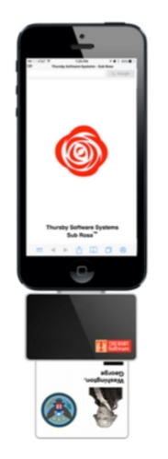

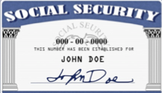
Security
App requires username and password or Single Sign On (SSO) credentials via a mobile Common Access Card (CAC) reader.
All files are “sandboxed” within the app meaning they are inaccessible from outside apps.
Forms may only be sent to other users using the same mobile app, web-based companion app or “.gov” or “.mil” email accounts.
All files marked For Official Use Only (FOUO) or containing Personal Identifiable Information (PII) can be sent encrypted and password protected to ensure confidentiality.
The web-based companion app will use the Secure Socket Layer (SSL) protocol to allow users to access, send, receive, and sync all files between on the user’s mobile application and web-based companion app.
Notes:
http://www.thursby.com/products/pkard-reader-apple
This app would only communicate with government-approved sister apps and only send or receive emails to and from .gov or .mil email accounts.
The app could have would use a robot email ”no reply” email when sending a form one way from the app to a government email.
The app would have a personal profile for the Marine and an OMB profile (for shared use and access).
Users of the app could pair the app to an USMC OMB, allowing Marines to send files directly to the app. Marines using the OMB-profile within the app could view, edit, send, and save the same files received or sent from other Marines also using the same OMB profiles.
Any forms received to the personal or shared OMB in the mobile app could be setup to be CC’d to the Marines official email, so they have the latest version in the inbox.
SAARs, and other forms could be digitally signed within the mobile app using soft certifications via industry standards fingerprint ID such as Apple’s Touch ID or Nexus Imprint.

Slide 10
Security
The mobile app will require login via Single Sign On (SSO) credentials or use of a mobile CAC reader.
All files are “sandboxed” within the app meaning there are inaccessible from outside apps.
All files in the mobile app can be password protected using industry encryption tools to ensure confidentiality.
All files marked For Official Use Only (FOUO) or containing Personal Identifiable Information (PII) can be sent encrypted to another user with the same mobile app.
The web based companion app will use the Secure Socket Layer (SSL) protocol to allow users to access and sync all files on the user’s mobile application within a web site.
The web based companion app will use the Secure Socket Layer (SSL) protocol to edit, create, send or receive files as they would within the mobile device.
The web based companion app will use the Secure Socket Layer (SSL) to be able to send and receive files between users whether they use the mobile app and web based app.
Notes:
http://www.thursby.com/products/pkard-reader-apple
This app would only communicate with government-approved sister apps and only send or receive emails to and from .gov or .mil email accounts.
The app could have would use a robot email ”no reply” email when sending a form one way from the app to a government email.
The app would have a personal profile for the Marine and an OMB profile (for shared use and access).
Users of the app could pair the app to an USMC OMB, allowing Marines to send files directly to the app. Marines using the OMB-profile within the app could view, edit, send, and save the same files received or sent from other Marines also using the same OMB profiles.
Any forms received to the personal or shared OMB in the mobile app could be setup to be CC’d to the Marines official email, so they have the latest version in the inbox.
SAARs, and other forms could be digitally signed within the mobile app using soft certifications via industry standards fingerprint ID such as Apple’s Touch ID or Nexus Imprint.

Slide 11

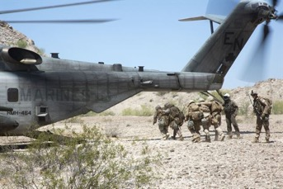
Benefits
Paperless
Reduce waste.
Maintain an electronic record of all forms for reference.
Mobile access to forms whether forward deployed, on ship, in the field, or in garrison.

Slide 12
Challenges
Integrating forms and files into common logistics applications such as CLC2S or TCPT.
If on a desktop, integration may require the user to use the companion web-based app to download the files/forms first then re-upload them to the preferred logistics application.
If on a mobile device, integration may require the user to first download the files/forms from the mobile app (bypassing the sandboxing feature) then re-upload files/forms to the logistics application such as CLC2S, which is only accessible with a CAC.
If forms are sent directly the user’s government email, the user would have to use Outlook Web Access (OWA) and forward the document to the mobile app before being able to work on it.
Workaround would be for the user to ask that forms be sent to his or her mobile app’s email address to work on it directly from the mobile device.

Slide 13
Questions?

Slide 14
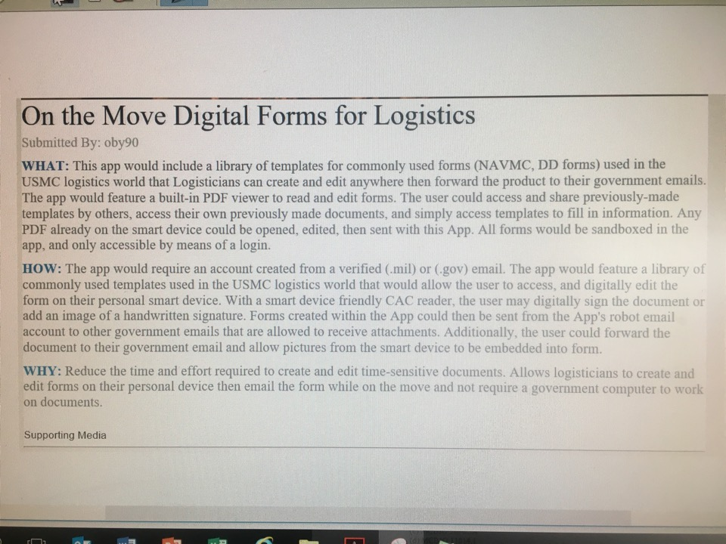

Slide 15
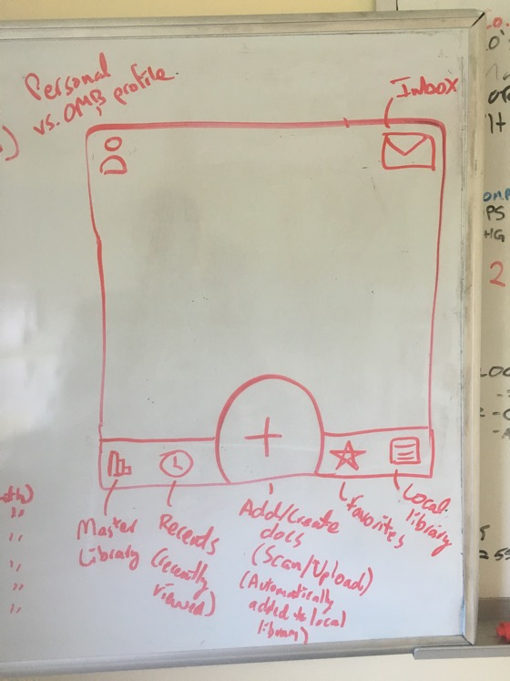

Slide 16
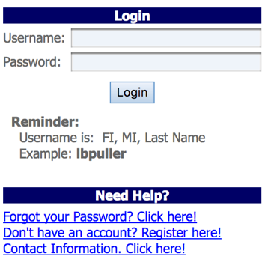
Welcome Screen
ALFA USMC
User accounts are created and paired with a government email
(for notification and account verification purposes)
Notes:
http://www.iconarchive.com/

Slide 17













Option#1 Home Screen (Master Library)
Change profiles
Personal Profile/OMB
Inbox
Sort A to Z or Z to A
Filter…
File Name; File Type;
File Size; Date Created;
Created By
Change from list to Grid View
PDF
Master Library
Favorited Files
Add Files
Saved/Local Files
Settings/extra options
XLS
Notes:
http://www.iconarchive.com/

Slide 18





Option#2 App Home Screen (Master Library)
Change profiles
Mailbox
Recents
Favorite Files
Local/Saved Files
Settings
Personal Profile/OMB
Change from list to Grid View
Sort by
Select…
Select All
File Name; File Type;
File Size; Date Created;
Created By
PDF
Filter by tags
Geographical Loc. (CONUS vs OCONUS)
Unit Type (CE, Ground, Air, Log, SP-MAGTF, Joint, Army, Navy, AirForce, Foreign.
Search by forms tied to Billet (MMMO, Motor-T, S4)
XLS
If by title, Sort A to Z or Z to A; If by date (newest vs oldest)
New File
Upload (from outside app)
Scan w/ Camera
Notes:
App Email idea: Alfa.usmc.mil

Slide 19
Option#2 Web-App Home Screen (Home)
Change profiles
Mailbox
Favorite Files
Local/Saved Files
Settings
Personal Profile/OMB
File Name; File Type;
File Size; Date Created;
Created By
PDF
XLS
ADD FILE(S)
Notes:
App Email idea: Alfa.usmc.mil

Slide 20
GCSS MOBILE ONE WAY UPDATE
GCSS MOBILE ONE WAY UPDATE
User selects one option
CAL | MOD | PMCS
RUC
S/N should match TAMCN, if not, the request is rejected
TAMCN
S/N
S/R #
Options would vary by option selected
CAL/MOD DATE
YYYYMMMDD
NEXT CAL DATE/NEW MILES/MOD STATUS/NEXT EOTC DATE
PROBLEM SUMMARY UPDATE
SUBMIT
Notes:
User account is linked to GCSS account whose role is by given the Unit User Account Manager (UUAM).
BIC dictates who rates a GCSS account.
When you submit a SAAR, mobile app permissions are specifically requested on the SAAR.

Slide 21
GCSS MOBILE ONE WAY UPDATE
GCSS MOBILE ONE WAY UPDATE
User selects one option
CAL | MOD | PMCS
RUC
S/N should match TAMCN, if not, the request is rejected
TAMCN
S/N
S/R #
Options would vary by option selected
CAL/MOD DATE
YYYYMMMDD
NEXT CAL DATE/NEW MILES/MOD STATUS/NEXT EOTC DATE
PROBLEM SUMMARY UPDATE
SUBMIT
Notes:
User account is linked to GCSS account whose role is by given the Unit User Account Manager (UUAM).
BIC dictates who rates a GCSS account.
When you submit a SAAR, mobile app permissions are specifically requested on the SAAR.

Slide 22
How File Transfers and Notifications would work
OPTION #1
Send a file directly from the mobile/web app to a government email. (one way)
Recipients with government emails will receive the file as is.
Recipients will receive a notification in the mobile app or in their government email from a “no-reply" email address that a file is available for download in the mobile/web app.
This option requires access to Global Address Lookup (GAL) for MC/USN email addresses OR DISA 411 Lookup
OPTION #2
Send a file directly between mobile/web apps to mobile/web apps. (in a vacuum)
Recipients will receive a notification in their government email from a “no-reply" email address that a file is available for download in the mobile/web app.
On the mobile device, users will receive a app notification that a file was sent to their inbox.
This option requires the recipient to have an account with the mobile/web app before receiving files. If no app-account is available, a notification to download a file will be sent to their government email.
OPTION #3
Send a file directly from mobile/web app to mobile/web app AND/OR government email.
Recipients will receive a notification in their government email from a “no-reply" email address that a file is available for download in the mobile/web app.
On the mobile device, users will receive a app notification that a file was sent to their inbox.
This option requires access to Global Address Lookup (GAL) for MC/USN email addresses OR DISA 411 Lookup
Notes:
Use AMRDEC SAFE Getting Started Guide as reference

Slide 23
Sourcing content for Master/Central Library
Ask units in the Marine Forces, USMC Logistics Command, MC Systems Command, and Supporting Establishment to send forms and files to HQMC to create a master library for mobile/web app.

Slide 24
Examples of Files to be used in the App
System Authorization Access Request (SAAR)
Flash Report
Special Meal Request
Expenditure Reports
Overnight Retention Letter
Letters for Temporary Storage
Letters of Transmittal
Selective Interchange Letters
DSI Approval Letters
1348
Electronic Custody Record (ECR)
Entry/exit letters for foreign countries
Multinational Logistics Support Request (MSLR)

Slide 25
SCENARIOS FOR USE OF THE APP
Scenario #1
A Marine has passed out during a platoon hike. Corpsmen were able to revive the Marine and provide medical attention. The command would like to know the full details of the situation as soon as possible. An NCO opens the mobile app, and uses the Flash Report template to submit information of the incident to his or her chain of command while still at the scene.
Scenario #2
Marines aboard a ship need to transfer gear locally but the printer is not working and there are no hard copy templates available. Marines with the mobile app use a digital 1348 or ECR card. This will serve as a receipt of transferring the custody of gear until paper copies are available.
Scenarios #3
Marines are requesting goods and services while in a foreign country. The Marines will require a Multinational Logistics Support Request (MSLR). An When Marines use a local vendor, the vendor will charge the local government’s military and they will in turn will charge the USMC. The MLSR serves as an agreement that the USMC will pay X amount of dollars to the local military who is serving as the middle man for locally procured goods and services. The ability to access, change, and send the latest MLRSs on the move would allow those on the ground to focus on the mission instead of paperwork.

Slide 26
TIMELINE
X = SD HACKS CONFERENCE
IOC DEVELOPMENT
FOC DEVELOPMENT
FOC IMPLEMENTATION
IOC
IMPLEMENTATION
X+12 MONTHS | X+18 MONTHS | X+24 MONTHS | X+36 MONTHS
Initial Operational Capable Development: Create an mobile app with the following features: Fill-In PDFs Phantom Email Data Repository maintained by HQMC CAC Login | Initial Operational Capable Implementation: Issue mobile CAC readers to participating logistics units Deploy mobile app to select logistic units Collective feedback from participating units | Final Operational Capable Development: Use feedback from units to improve mobile app Add ability to submit forms into CLC2S, TCPT, GCSS Add ability to use mobile device’s biometrics for secure login | Final Operational Capable Implementation: Issue mobile CAC readers to all 04XX Deploy mobile app to marketplace for download
6-12 MONTHS | 12-18 MONTHS | 19-24 MONTHS | 25-36 MONTHS

Slide 27









Logo Library
Notes:
http://www.iconarchive.com/

